Slide 1
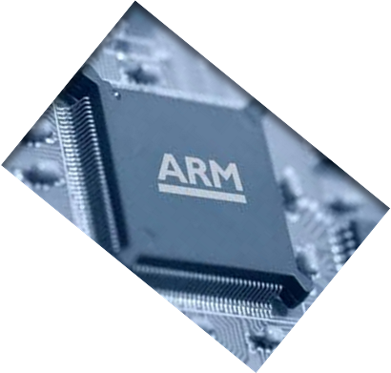

MICROPROCESSOR AND COMPUTER ARCHITECTURE
CACHE
PERFORMANCE
Credits:
MPCA Team
Notes:
1

Slide 2
Performance considerations
A key design objective is to achieve the best possible performance at the lowest possible cost.
Price/performance ratio is a common measure.
Performance of a processor depends on:
How fast machine instructions can be brought into the processor for execution.
How fast the instructions can be executed.
Notes:
2

Slide 3
Performance considerations
Memory hierarchy described earlier was created to increase the speed and size of the memory at an affordable cost.
Data need to be transferred between various units of this hierarchy as well.
Speed and efficiency of data transfer between these various memory units also impacts the performance.
Notes:
3

Slide 4
Performance enhancements - prefetching
New data are brought into the processor when they are first needed.
Processor has to wait before the data transfer is complete.
Prefetch the data into the cache before they are actually needed, or a before a Read miss occurs.
Prefetching should occur (hopefully) when the processor is busy executing instructions that do not result in a read miss.
Notes:
4

Slide 5
Performance enhancements - prefetching
Prefetching can be accomplished through software by including a special instruction in the machine language of the processor.
- Inclusion of prefetch instructions increases the length of the programs.
Prefetching can also be accomplished using hardware:
- Circuitry that attempts to discover patterns in memory references and then prefetches according to this pattern.
Notes:
5

Slide 6
Performance enhancements - prefetching
Prefetching can be accomplished through software by including a special instruction in the machine language of the processor.
- Inclusion of prefetch instructions increases the length of the programs.
Prefetching can also be accomplished using hardware:
- Circuitry that attempts to discover patterns in memory references and then prefetches according to this pattern.
Notes:
6

Slide 7
Performance enhancements – lockup free cache
Prefetching scheme does not work if it stops other accesses to the cache until the prefetch is completed.
A cache of this type is said to be “locked” while it services a miss.
Cache structure which supports multiple outstanding misses is called a lockup free cache.
Since only one miss can be serviced at a time, a lockup free cache must include circuits that keep track of all the outstanding misses.
Special registers may hold the necessary information about these misses.
Notes:
7

Slide 8



Cache performance
The Processor Performance Equation
Notes:
8

Slide 9
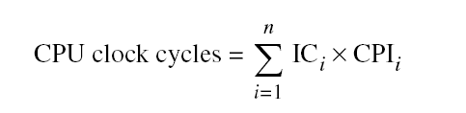
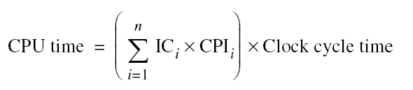
Cache performance
Different instruction types having different CPIs
One method to evaluate cache performance is to expand processor execution time.
Add memory stall cycles - the number of cycles during which the processor is waiting for a memory access.
CPU Execution = (CPU clock cycles + Memory stall cycles) x Clock cycle execution time
Notes:
10-03-2020
9

Slide 10
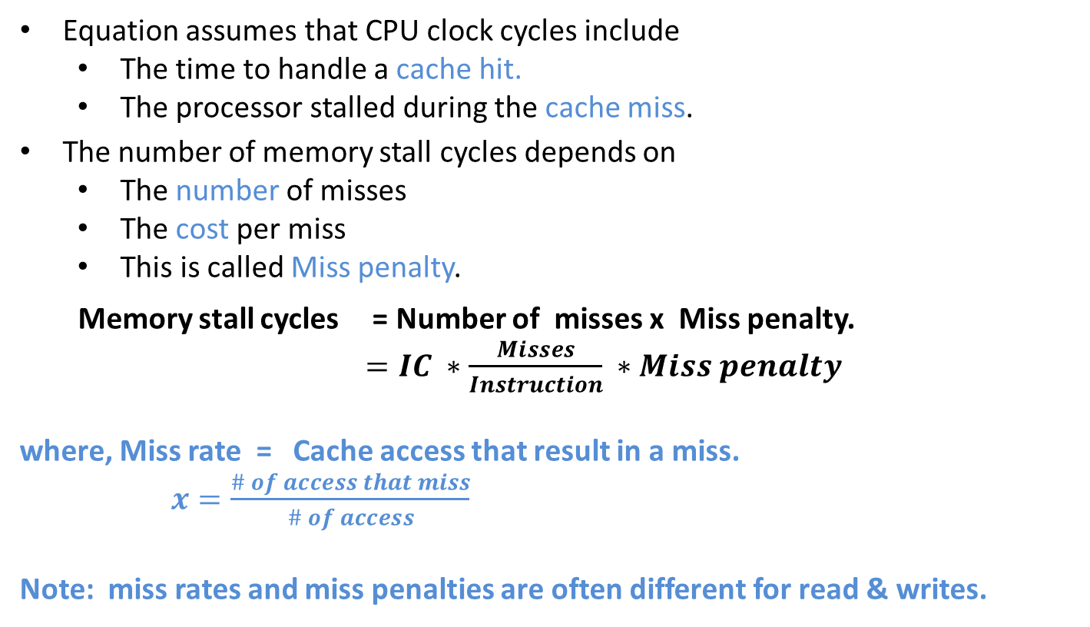
Cache performance
Notes:
10-03-2020
10

Slide 11
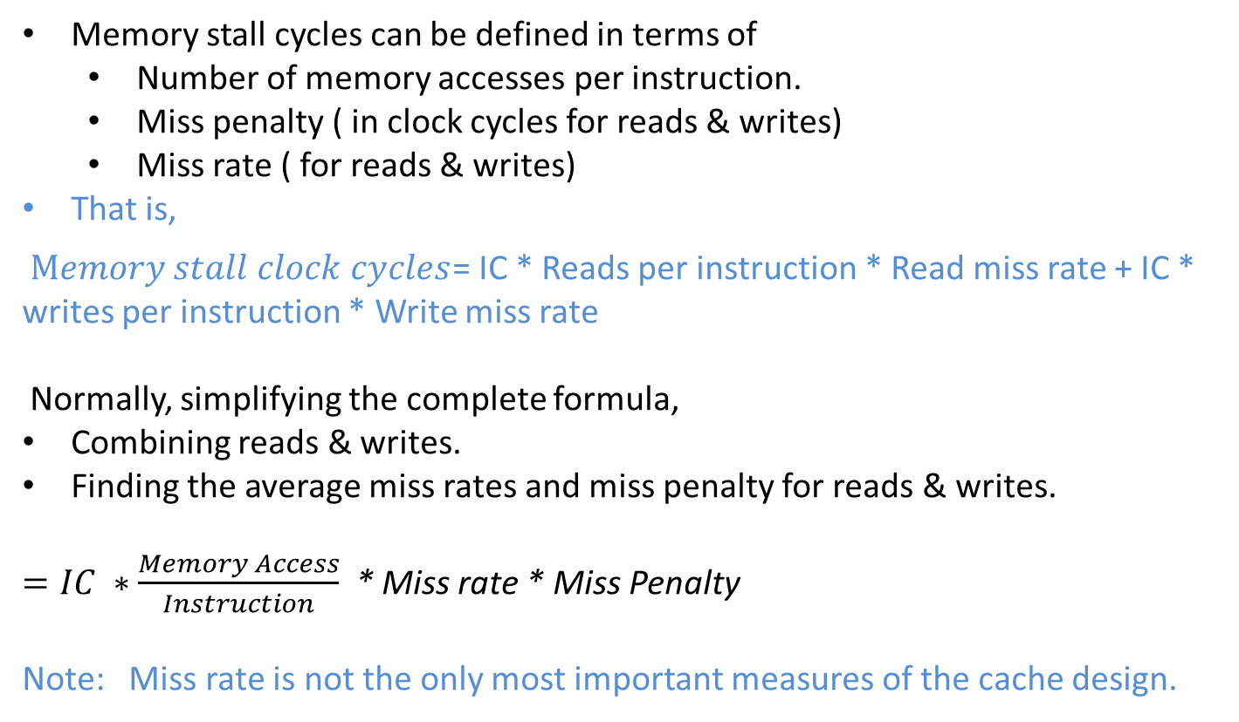
Cache performance
Notes:
10-03-2020
11

Slide 12
Cache performance – example 1
Assume we have a computer where the cycles per instruction (CPI) is 1.0 when all memory accesses hit in the cache. The only data accesses are loads and stores, and these total 50% of the instructions. If the miss penalty is 25 clock cycles and the miss rate is 2%, how much faster would the computer be if all instructions were cache hits?
SOLUTION:
First compute the performance for the computer that always hits:
CPU execution time = ( CPU clock cycles + Memory stall cycles) × Clock cycle
= ( IC × CPI + 0) × Clock cycle
= IC × 1.0 × Clock cycle
Now for the computer with the real cache, first we compute memory stall cycles:
Notes:
10-03-2020
12

Slide 13
Cache performance – example 1
where the middle term (1 + 0.5) represents one instruction access and 0.5 data accesses per instruction. The total performance is thus
CPU execution time cache = (IC × 1.0 + IC × 0.75) × Clock cycle
= 1.75 × IC × Clock cycle
The performance ratio is the inverse of the execution times:
Hence, The computer with no cache misses is 1.75 times faster.
Notes:
10-03-2020
13

Slide 14
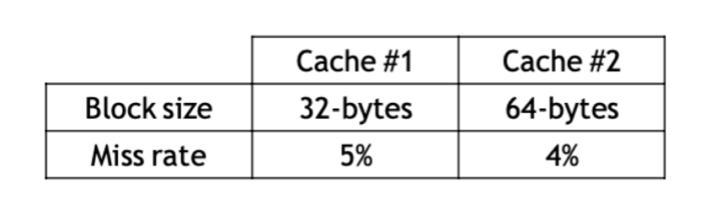
Cache performance – example 2
Which cache configuration would be better?
Assume both caches have single cycle hit times.
Memory accesses take 15 cycles, and the memory bus is 8-bytes wide
Notes:
10-03-2020
14

Slide 15
Cache performance – example 2
Cache #1
For a 32-byte memory access takes 20 cycles:
1 (send address) + 15 (memory access) + 4 (four 8-byte transfers)
Miss Penalty=1+15+32B/8B=20cycles • AMAT=1+0.05x20=2
Cache #2
For a 64-byte memory access takes 24 cycles:
1 (send address) + 15 (memory access) + 8 (four 8-byte transfers)
Miss Penalty = 1 + 15 + 64B/8B = 24 cycles • AMAT = 1 + 0.04 x 24 = 1.9
Notes:
10-03-2020
15

Slide 16
Cache performance – example 3
Assume that 33% of the instructions in a program are data accesses. The cache hit ratio is 97% and the hit time is one cycle, but the miss penalty is 20 cycles.
SOLUTION:
Memory stall cycles = Memory accesses x Miss rate x Miss penalty
= 0.33 x 0.03 x 20 cycles
= 0.2 cycles
CPI =[1 + 0.2] = 1.2 CPU
Execution Time = IC x 1.2 x cycle Time
Notes:
10-03-2020
16

Slide 17
Cache performance – example 4
Consider a pipelined processor that has an average CPI of 1.8 without accounting for memory stalls. I-Cache has a hit rate of 95% and the D-Cache has a hit rate of 98%. Assume that memory reference instructions account for 30% of all the instructions executed. Out of these 80% are loads and 20% are stores. On average, the read-miss penalty is 20 cycles and the write-miss penalty is 5 cycles. Compute the effective CPI of the processor accounting for the memory stalls.
Notes:
10-03-2020
17

Slide 18
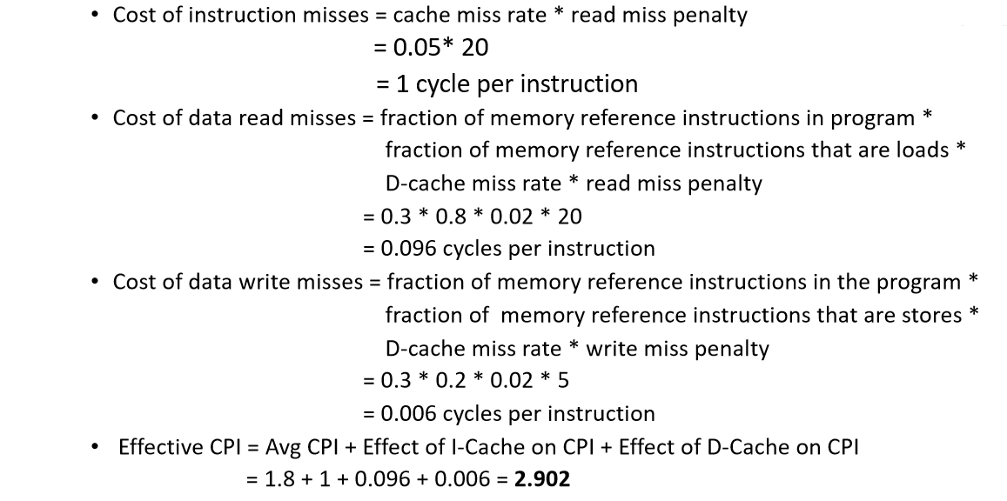
Cache performance – example 4
Notes:
10-03-2020
18

Slide 19
Q & A
Cache Performance
Notes:
10-03-2020
19

